Slide 1

LECTURE 1: Introduction
Shi Wenxuan
Nankai University

Slide 2
Course Information
The key objective of this course is to learn modular design of software and documenting the design using symbolic representations, i.e., UML diagrams.
The course covers software life-cycle models and different phases of the software development process.

Slide 3
Textbooks
Russ Miles and Kim Hamilton: Learning UML 2.0
Reilly Media, Inc. 2006.
Amazon.com: http://www.amazon.com/Learning-UML-2-0-Russ-Miles/dp/0596009828
Robert W. Sebesta: Programming the World Wide Web, 8th edition
Addison-Wesley, 2014.
Amazon.com: http://www.amazon.com/Programming-World-Wide-Web-8th/dp/0133775984/
Scott Chacon and Ben Straub: Pro Git, 2nd edition
Apress, 2014. (2nd ed. 2014 edition)
Amazon.com: http://www.amazon.com/Pro-Git-Scott-Chacon/dp/1484200772/

Slide 4
Course Projects
Hands-on design projects are the key component of the course. Team work is required for the projects.
  The purpose of the course project is to provide the students with the knowledge of software engineering methodology and the skills to apply it.
  The particular project is not the goal in itself; rather, it serves as a vehicle to apply your knowledge and to develop the skills.

Slide 5
Introduction: Software is Complex
Complex ≠ complicated
Complex = composed of many simple parts
related to one another
Complicated = not well understood, or explained

Slide 6




Complexity Example:
Scheduling Fence Construction Tasks
Setting posts
[ 3 time units ]
Cutting wood
[ 2 time units ]
Nailing
[ 2 time units for unpainted;
3 time units otherwise ]
Painting
[ 5 time units for uncut wood;
4 time units otherwise ]
Setting posts < Nailing, Painting
Cutting < Nailing
…shortest possible completion time = ?
[ ⇒ “simple” problem, but hard to solve without a pen and paper ]
Notes:
SOURCE: Goodaire & Parmenter, Discrete Mathematics with Graph Theory, Third Edition, Pearson Prentice Hall, 2006. [ Section 11.5, p. 361 ]

Slide 7

The Role of Software Engg. (1)
A bridge from customer needs to programming implementation
Customer
Software Engineering
Programmer
First law of software engineering
Software engineer is willing to learn the problem domain
(problem cannot be solved without understanding it first)
Notes:
"You cannot solve it, unless you understand it."

Slide 8
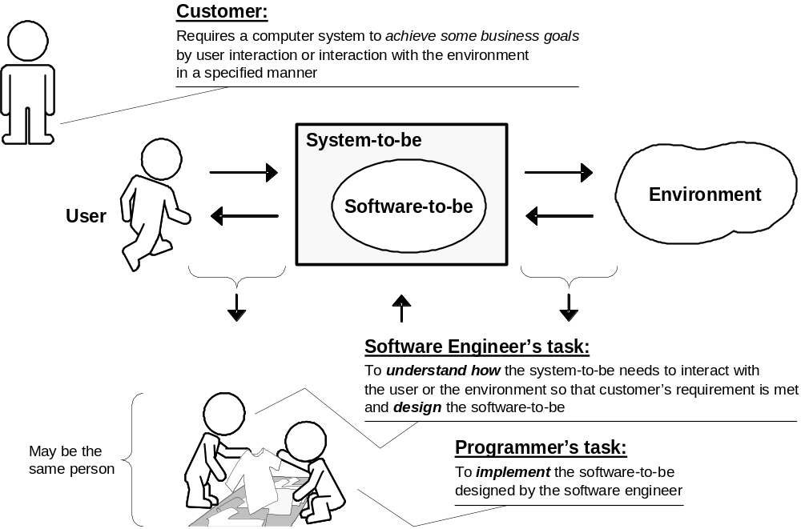
The Role of Software Engg. (2)

Slide 9
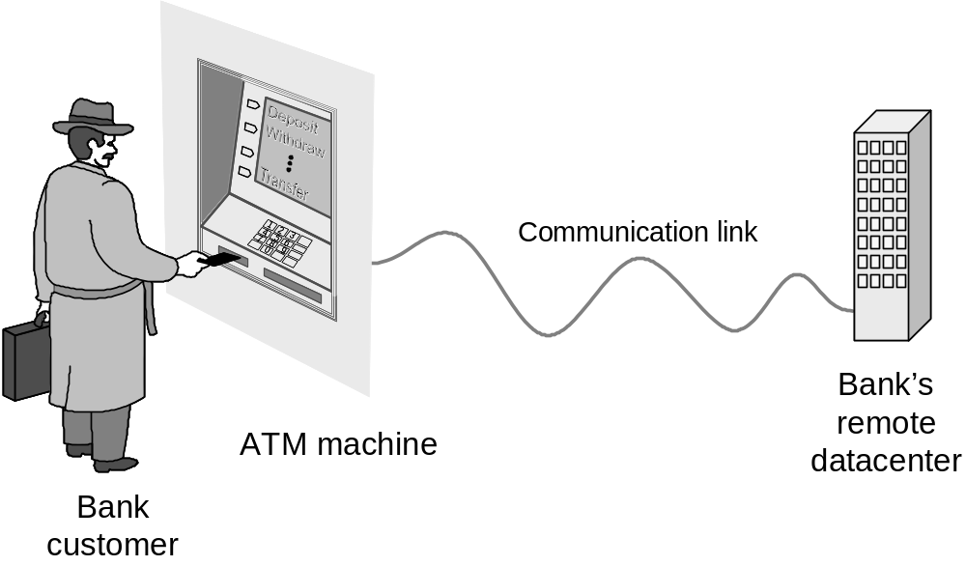
Example: ATM Machine
Understanding the money-machine problem:

Slide 10
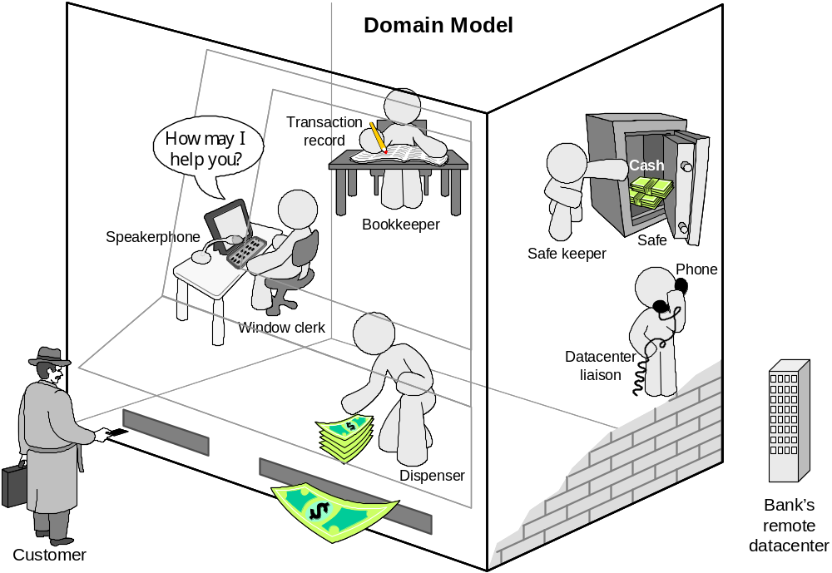
How ATM Machine Might Work
Domain model created with help of domain expert

Slide 11
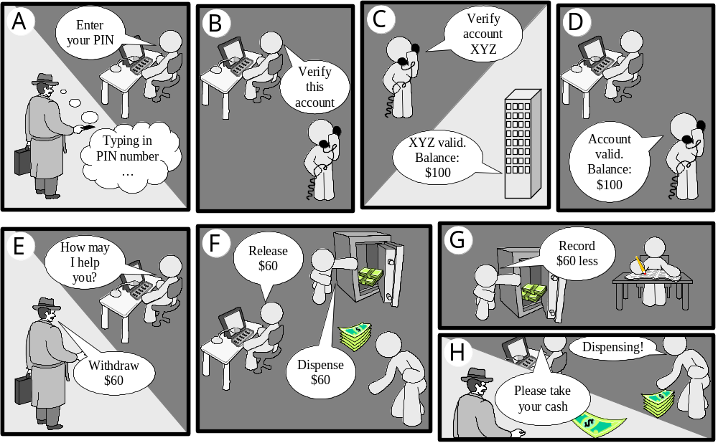
Cartoon Strip: How ATM Machine Works

Slide 12
Software Engineering Blueprints
Specifying software problems and solutions is like cartoon strip writing
Unfortunately, most of us are not artists, so we will use something less exciting:
UML symbols
However …

Slide 13
Why Software Engineering Is Difficult
“Software is like entropy. It is difficult to grasp, weighs nothing, and obeys the second law of thermodynamics; i.e., it always increases.” —Norman R. Augustine
When developing software, you need to know about software domain (because that is what you are building) and you need to know about the problem domain (because that is what you are building a solution for).

Slide 14
Software Engineering Lifecycle
Any product development can be expected to proceed as an organized process that usually includes the following phases:
  Planning / Specification
  Design
  Implementation
  Evaluation

Slide 15
Software Development Methods
Method = work strategy
    The Feynman Problem-Solving Algorithm:
    (i) Write down the problem (ii) think very hard, and (iii) write down the answer.
Waterfall
    Unidirectional, finish this step before moving to the next
Iterative + Incremental
    Develop increment of functionality, repeat in a feedback loop
Agile
    User feedback essential; feedback loops on several levels of granularity

Slide 16
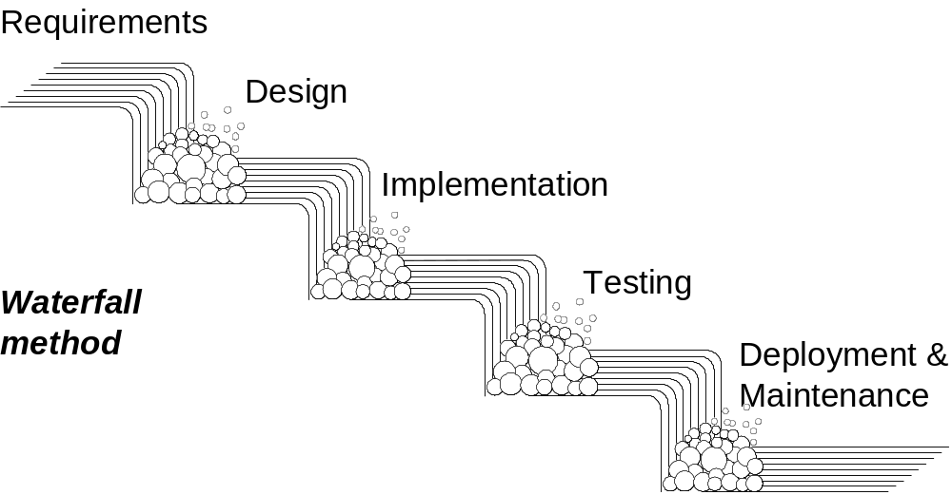
Waterfall Method
Unidirectional, no way back
finish this step before moving to the next

Slide 17
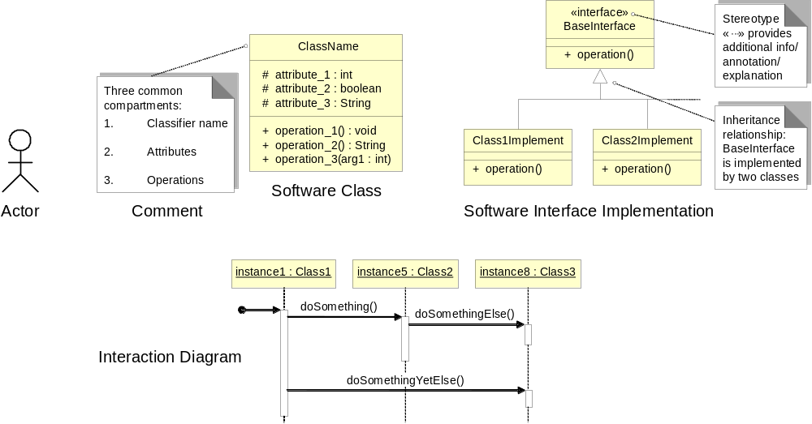
UML – Language of Symbols
UML = Unified Modeling Language
Online information:
http://www.uml.org

Slide 18
Understanding the Problem Domain
System to be developed
Actors
  Agents external to the system
Concepts/ Objects
  Agents working inside the system
Use Cases
  Scenarios for using the system

Slide 19
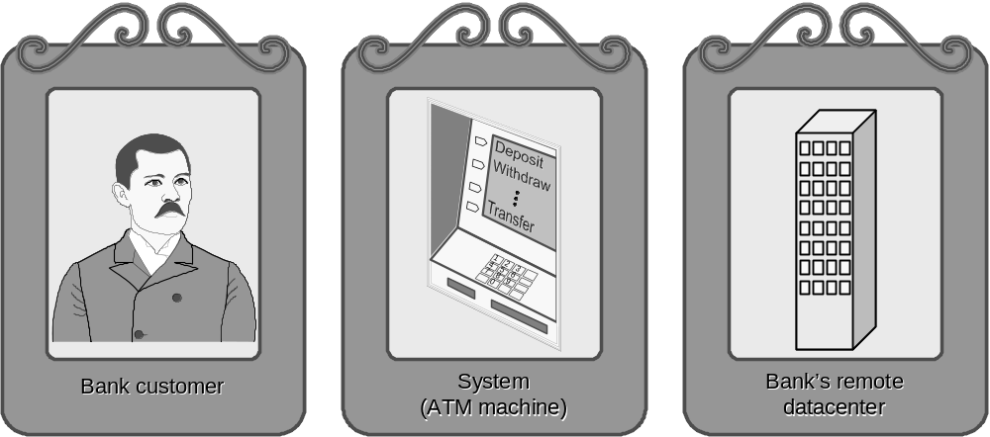
ATM: Gallery of Players
Actors
(Easy to identify because they are visible!)

Slide 20
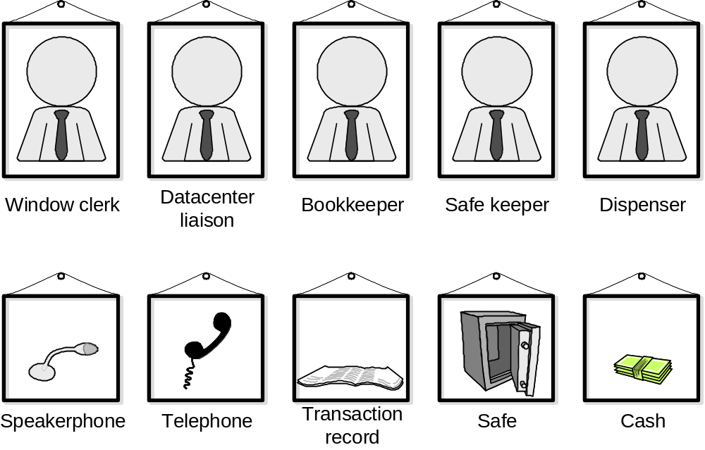
Gallery of Workers + Things
Concepts
(Hard to identify because they are invisible/imaginary!)

Slide 21
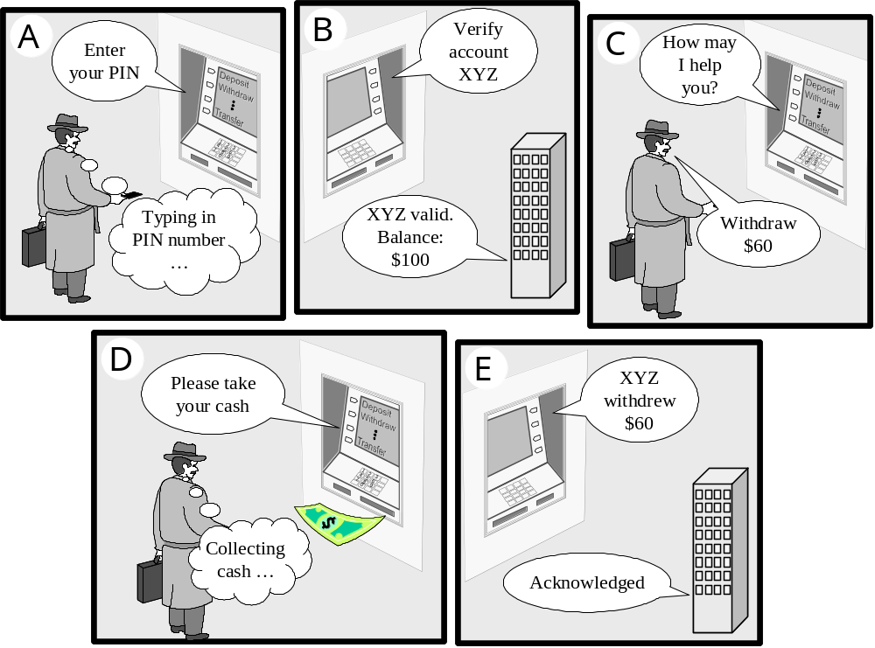
Use Case: Withdraw Cash

Slide 22
Object-Oriented Design
“Design is not just what it looks like and feels like. Design is how it works.”—Steve Jobs
In software development, the key activity in the design phase is assigning responsibilities to software objects.
A software application can be seen as a set or community of interacting software objects.

Slide 23
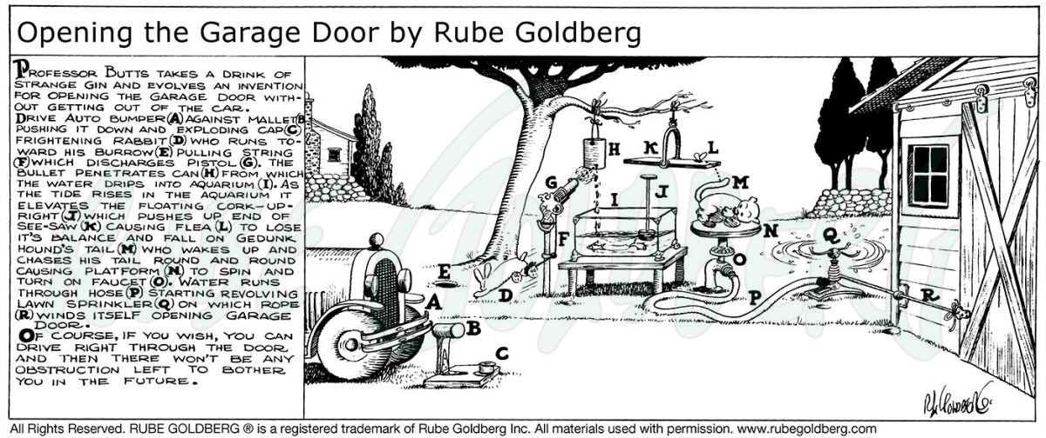
Rube Goldberg Design
Garage door opener：Rube Goldberg's cartoons became well known for depicting complicated devices that performed simple tasks in indirect convoluted ways.

Slide 24
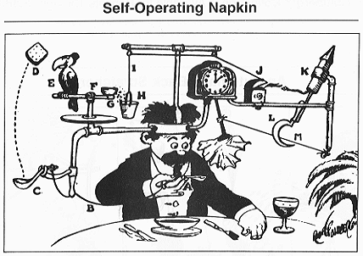
Some discussion
Goldberg designs are highly-complicated contraptions, which solve the problem, but they are very brittle.
If anything changes in the underlying assumptions, they fail miserably.

Slide 25
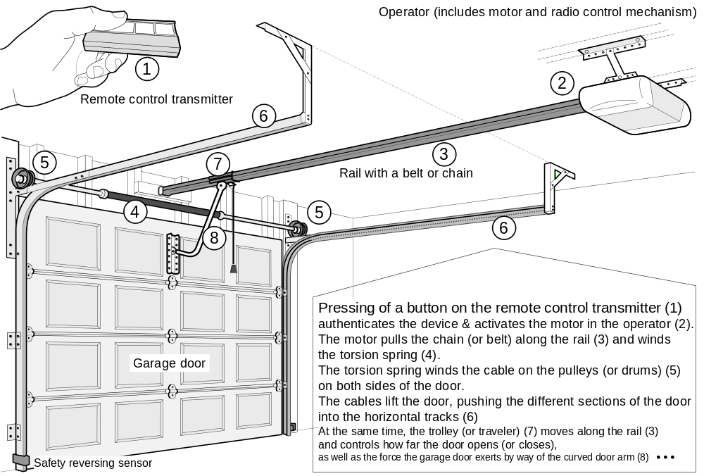
Actual Design

Slide 26
Software Measurement
What to measure?
  Project (developer’s work),
  for budgeting and scheduling
  Product,
  for quality assessment

Slide 27
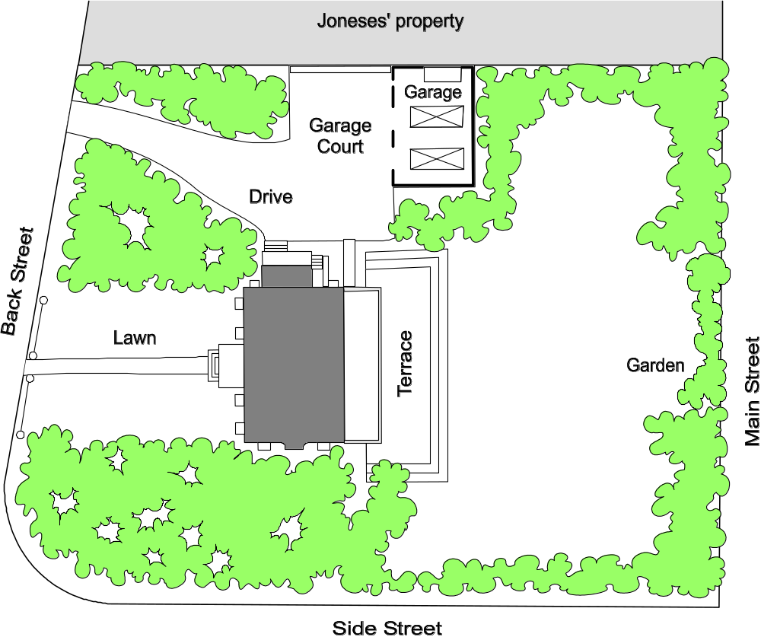
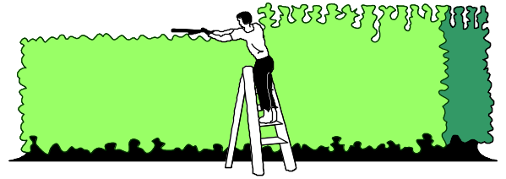
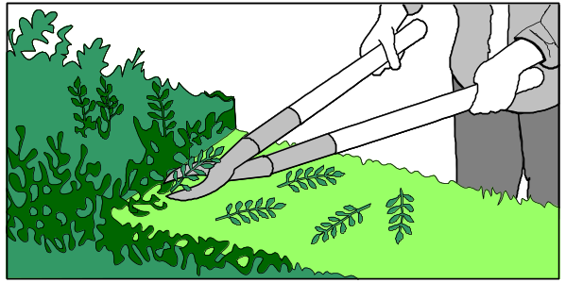
Formal hedge pruning

Slide 28
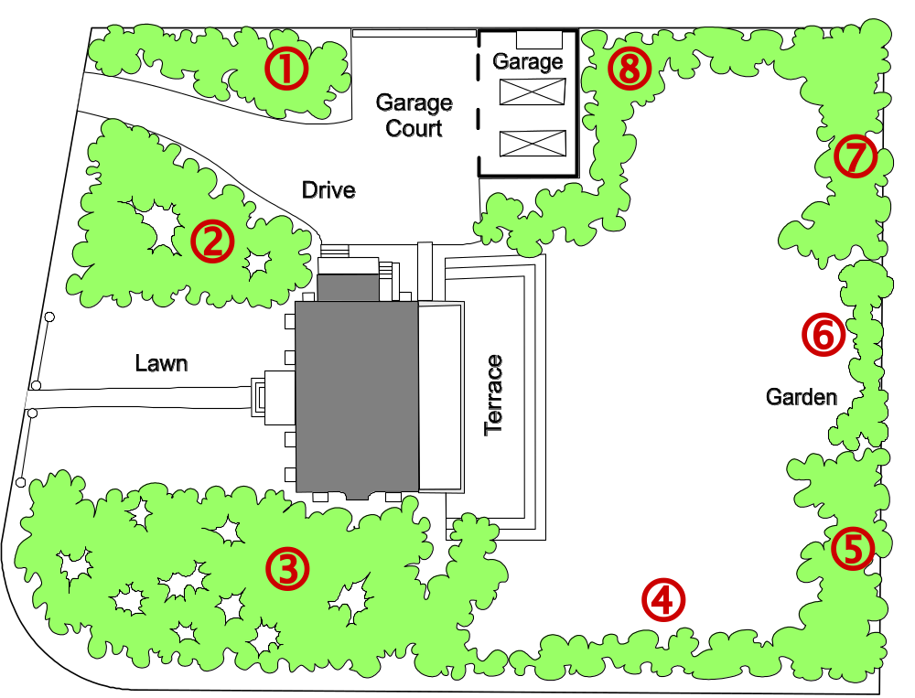
Sizing the Problem (1)
Step 1: Divide the problem into small & similar parts
Step 2:
Estimate relative sizes of all parts
Size(  ) = 4
Size(  ) = 7
Size(  ) = 10
Size(  ) = 3
Size(  ) = 4
Size( □ ) = 2
Size(  ) = 4
Size(  ) = 7

Slide 29
Sizing the Problem (2)
Step 3: Estimate the size of the total work
Total size = Σ points-for-section i (i = 1..N)
Step 4: Estimate speed of work (velocity)
Step 5: Estimate the work duration
Travel duration =
Path size
Travel velocity

Slide 30
Sizing the Problem (3)
Advantages:
  Velocity estimate may need to be adjusted (based on observed progress)
  However, the total duration can be computed quickly (provided that the relative size estimates of parts are accurate – easier to achieve if the parts are small and similar-size)

Slide 31
Exponential Cost of Estimation
100%
Estimation accuracy
Estimation cost
Improving accuracy of estimation beyond a certain point requires huge cost and effort (known as the law of diminishing returns)
In the beginning of the curve, a modest effort investment yields huge gains in accuracy

Slide 32
Estimation Error Over Time
Estimation
error
Requirements
Design
Implementation
Start
Completion
Time
The cone of uncertainty starts high and narrows down to zero as the project approaches completion.
Notes:
Barry Boehm, Software Engineering Economics, Prentice-Hall, 1991.

Slide 33
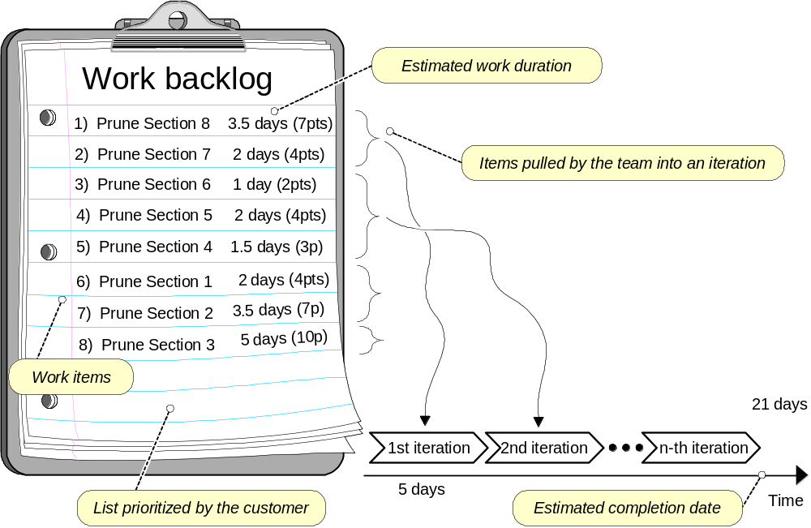
Agile Project Effort Estimation

Slide 34
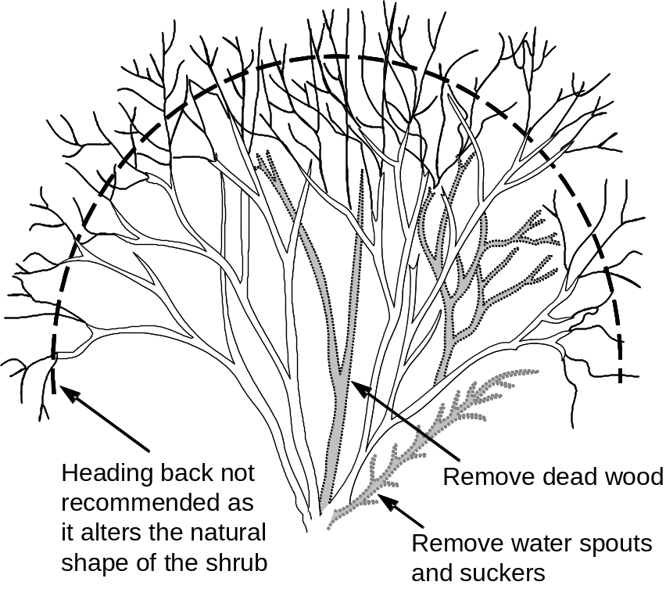
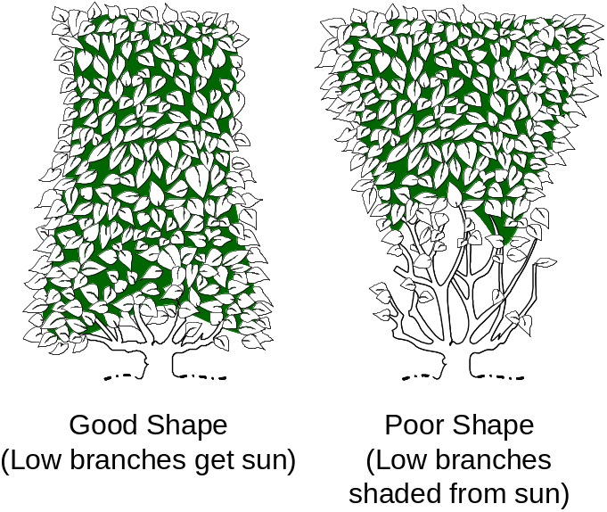
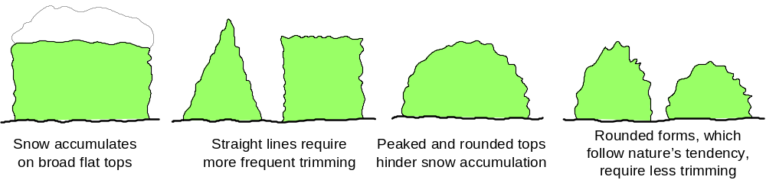
Measuring Quality of Work

Slide 35
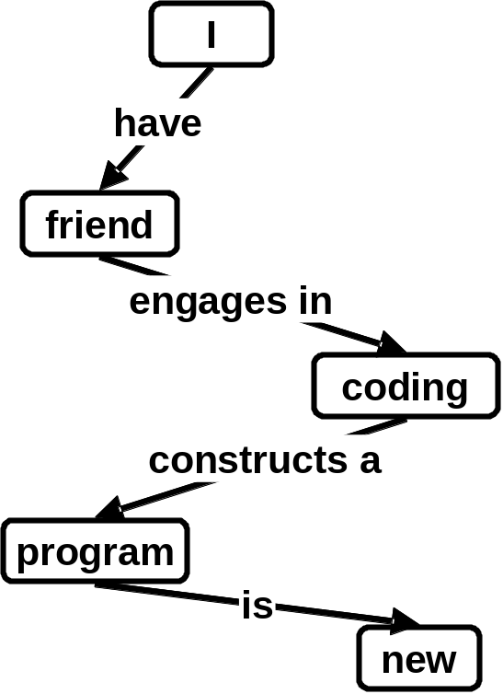
Concept Maps
Useful tool for problem domain description
SENTENCE: “My friend is coding a new program”
translated into propositions
Proposition | Concept | Relation | Concept
1. | I | have | friend
2. | friend | engages in | coding
3. | coding | constructs a | program
4. | program | is | new
Search the Web for Concept Maps

Slide 36
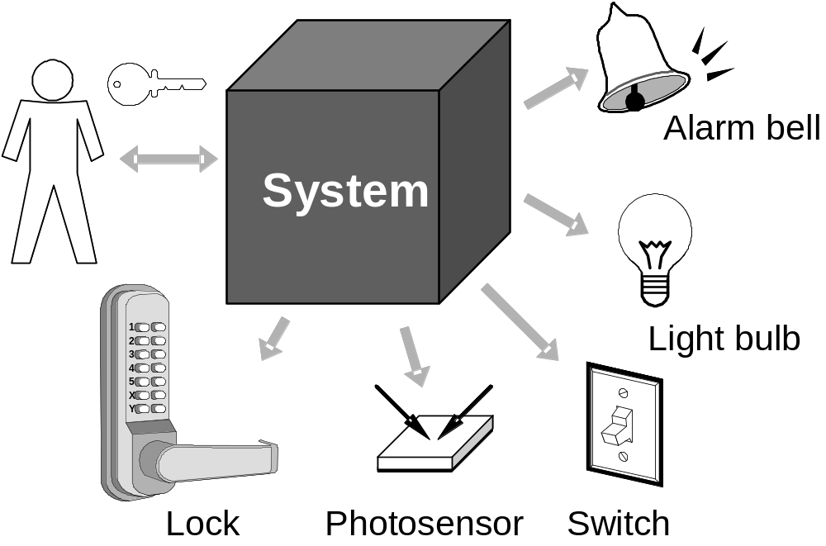
Case Study: Home Access Control
Objective: Design an electronic system for:
  Home access control
    Locks and lighting operation
  Intrusion detection and warning

Slide 37
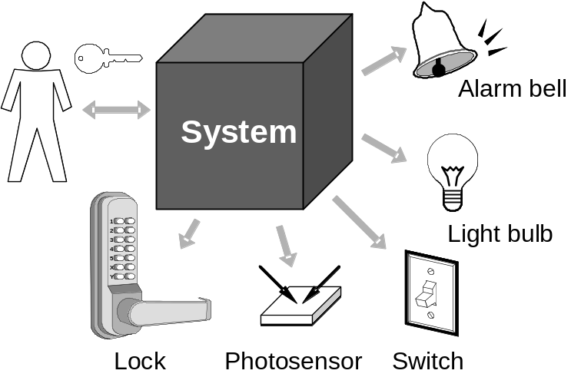
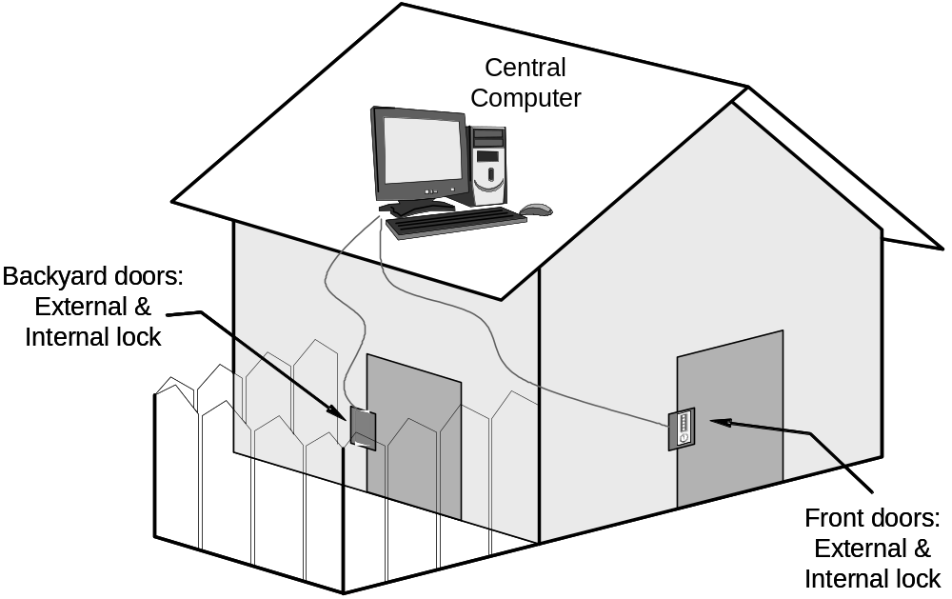
Case Study – More Details

Slide 38
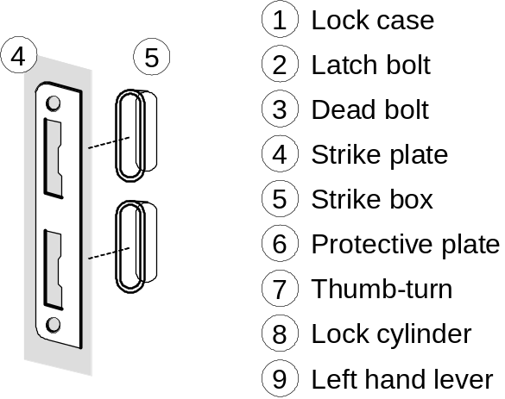
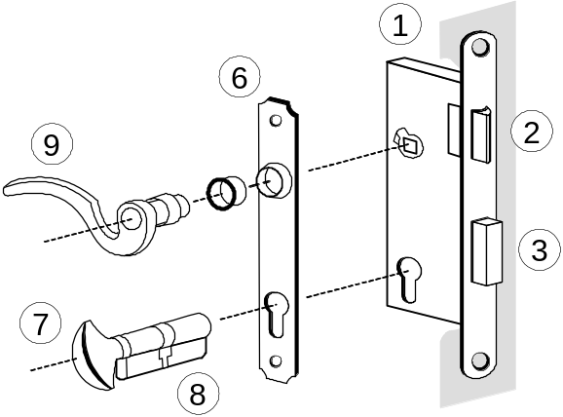
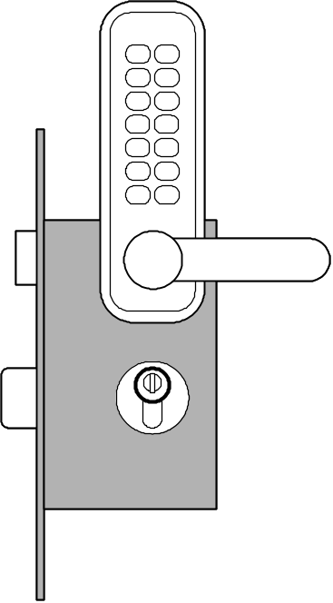
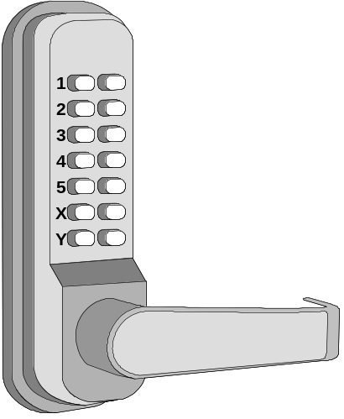
Know Your Problem
Mortise Lock Parts

Slide 39
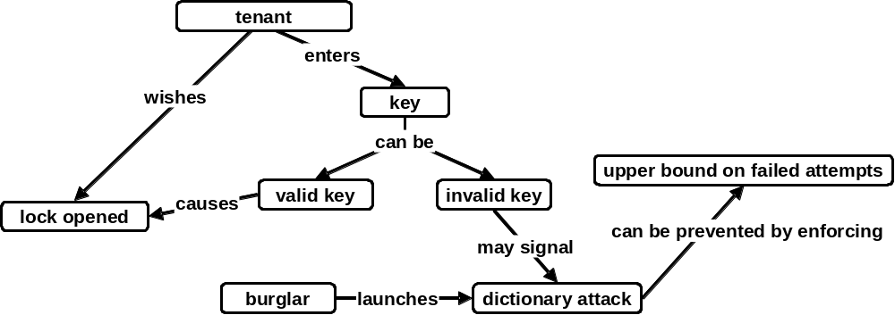
Concept Map for Home Access Control

Slide 40
States and Transition Rules
IF validKey AND holdOpenInterval THEN unlock
IF validKey THEN unlock
locked
unlocked
IF pushLockButton THEN lock
IF timeAfterUnlock ≥ max{ autoLockInterval, holdOpenInterval } THEN lock
… what seemed a simple problem, now is becoming complex

Slide 41
Software Development Methods
Four major software development methodologies
  Structured analysis and design (SAD)
  Object-oriented analysis and design (OOAD)
  Agile software development (ASD)
  Aspect-oriented software development (AOSD)

Slide 42
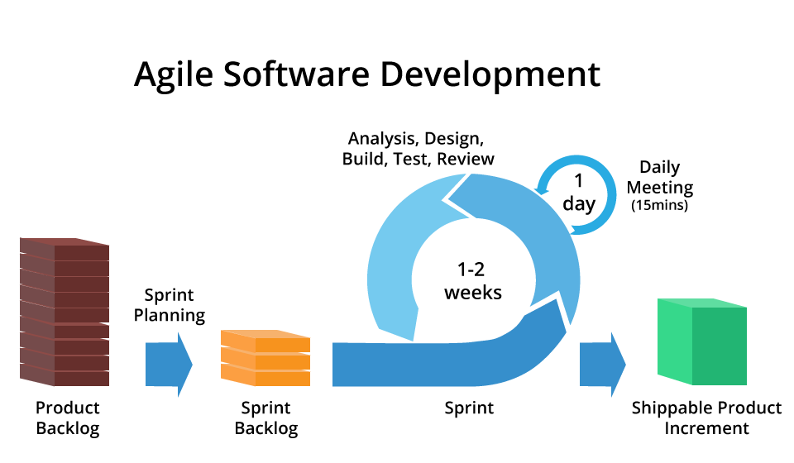
Agile software development
ASD advocates adaptive planning, evolutionary development, early delivery, and continuous improvement, and it encourages rapid and flexible response to change.

Slide 43
Agile software development values
Individuals and Interactions over processes and tools
Working Software over comprehensive documentation
Customer Collaboration over contract negotiation
Responding to Change over following a plan

Slide 44
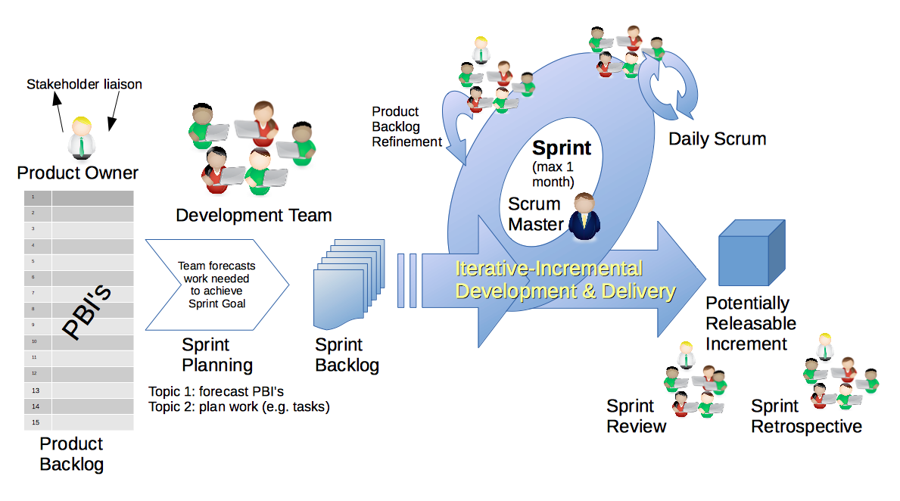
Scrum
Scrum is an agile framework for managing work with an emphasis on software development.

Slide 45
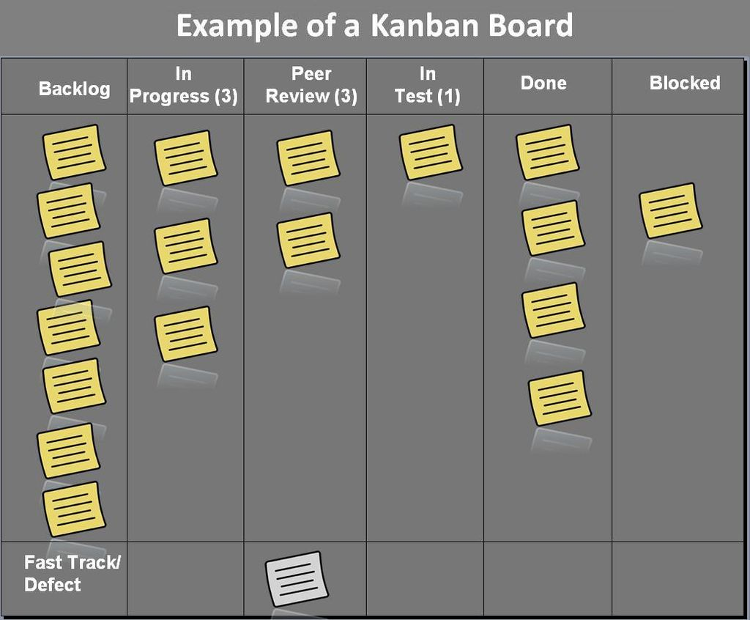
Kanban
Kanban is a lean method to manage and improve work across human systems.

